Slide 1

Lot 64 Solar Canopy
Business Plan & Engineering Economic Analysis Plan
Team Kappa: Shrey Patel, Dhruvil Patel, Pujita Vijaykumar, Dyuti Soudarapu
Advance Engineering Economics
Instructor: Randy Reagan

Slide 2
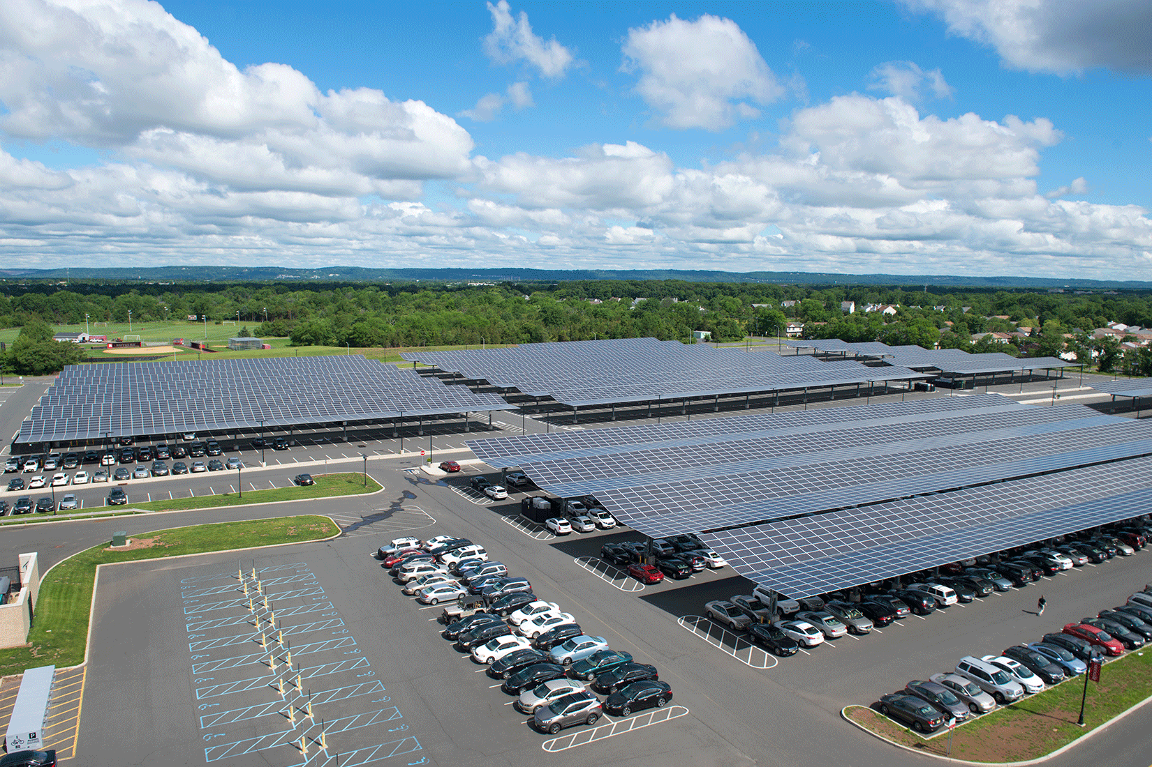
Content
Executive Summary
Opportunity Statement
Description of Alternatives
Detailed Cost Estimate of Alternatives
Cash Flow Diagrams
Depreciation
Comparison Among Alternatives
Breakeven Analysis
Sensitivity Analysis
Probabilistic Risk Analysis
Multi-attribute Analysis
Conclusion

Slide 3
Executive Summary
The project aims to encourage environmentally responsible behaviors and meet the rising demand for clean energy.
Implementation of the solar parking canopy in Parking Lot 64, powers both the recreation center and the core building at the university .
The solar canopy serves dual purpose of collecting solar energy and providing shade for parked cars.
Installation of a bank of electric car chargers to accommodate the growing number of staff and teachers with electric vehicles. Thereby, supporting the transition to electric vehicles.
The proposed solar parking canopy emerges as the most viable and beneficial solution for the university's energy needs and environmental goals.

Slide 4
Opportunity Statement
Contemplating the addition of a solar parking canopy in Parking Lot 64, coupled with the integration of electric car chargers near the CORE building, the project aspires to not only meet the immediate energy needs of the Recreation Center and the Core Building but also position itself as a leader in environmental sustainability
This initiative aligns with the evolving landscape of clean energy trends and presents a unique chance to demonstrate environmental stewardship, reduce dependency on conventional power sources, and foster a culture of responsible energy consumption.
The proposal contribute to the long-term financial sustainability of the university ,also exemplify its commitment to innovation and leadership in the realm of green initiatives

Slide 5
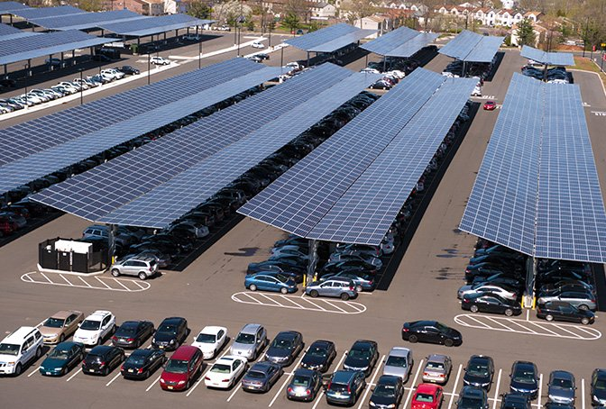
Solar PV Grid
Description of Alternatives
Used for both commercial and residential purposes
Widely used form of clean/renewable energy generation method
Requires relatively less initial capital investment
Low operational and maintenance cost
Average lifespan of the project exceeds 25 years with advancements in technology
Increasing energy conversion efficiency with research and development of new PV materials
Types of Solar PV modules available in market; Monocrystalline. Multicrystalline, Thin-film, HIT

Slide 6
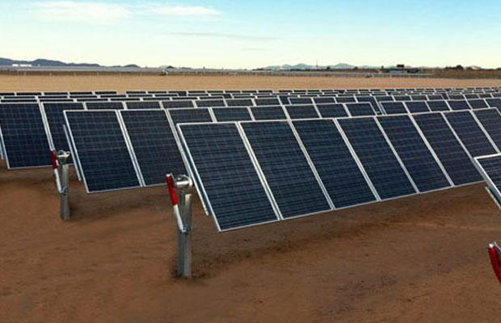
Single Axis Tracking System PV Grid
Description of Alternatives
More suitable for commercial use as compared to residential use
Receives more solar irradiance by keeping panel normal to radiation by tracking it
Help generate more electricity with fewer solar panels
Less area required due to fewer panels
Requires relatively more initial capital investment than normal PV grid
High operational and maintenance cost due to more complex technology and moving parts
Average lifespan of the project exceeds 25 years
Other popular PV modules include Monofacial and Bifacial panels

Slide 7
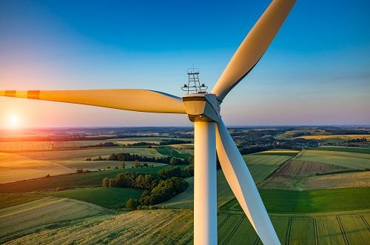
Wind turbine
Description of Alternatives
Geography plays an important role in setting up wind turbine plant
Generally preferred at higher altitudes where wind velocity is high
High energy conversion efficiency with least carbon emission
Large area required as compared to all other alternatives
Requires very high initial capital investment than any normal PV system
High operational and maintenance cost due to more complex technology and moving parts
Average lifespan of the project is 20- 25 years
Customization like angle adjusting rotor blades available to maximize the efficiency

Slide 8
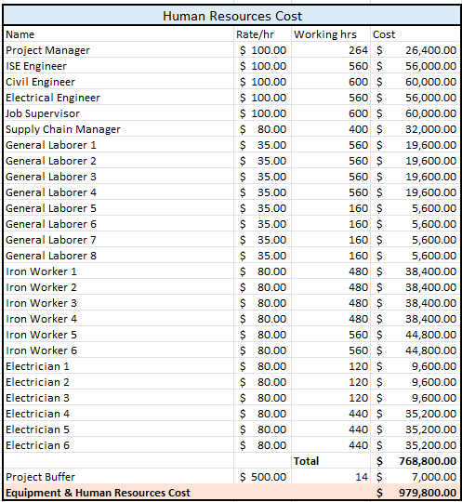
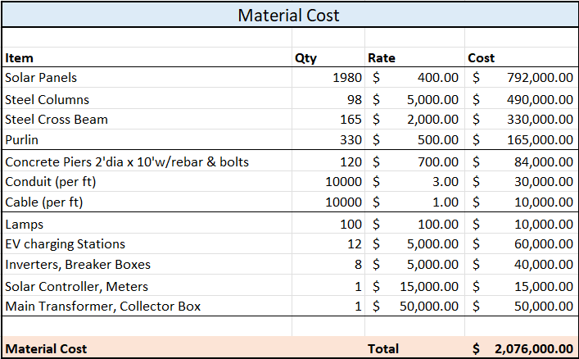
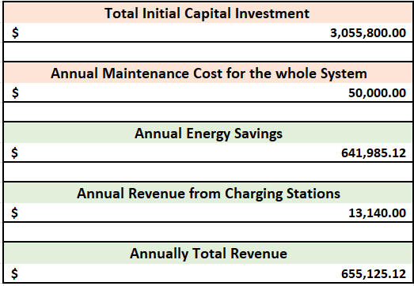
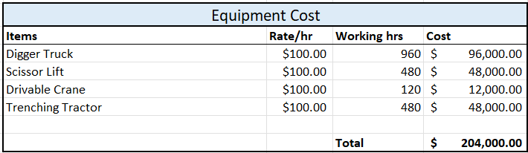
Cost Associated with Solar Canopy

Slide 9
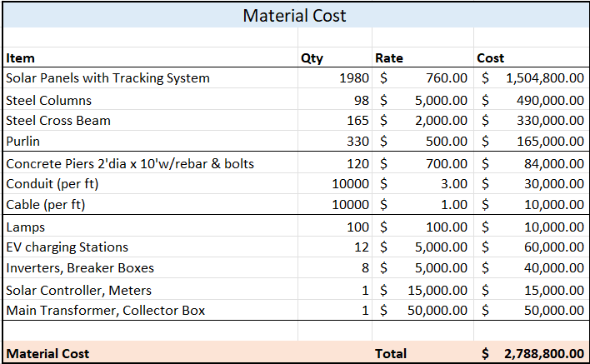
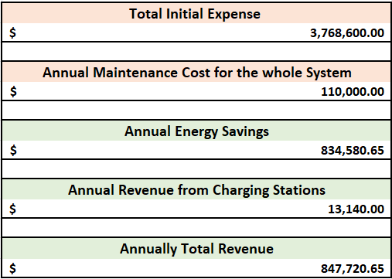
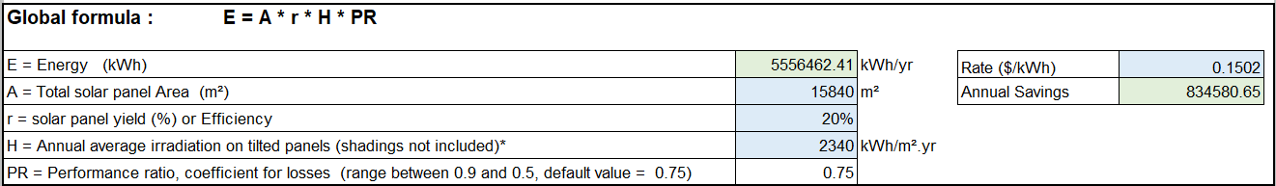
Detailed Cost Estimate of Tracking System

Slide 10
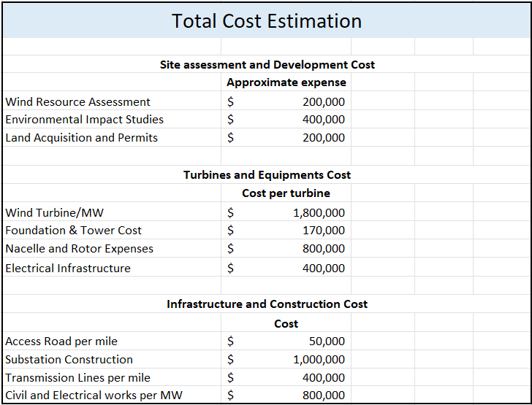
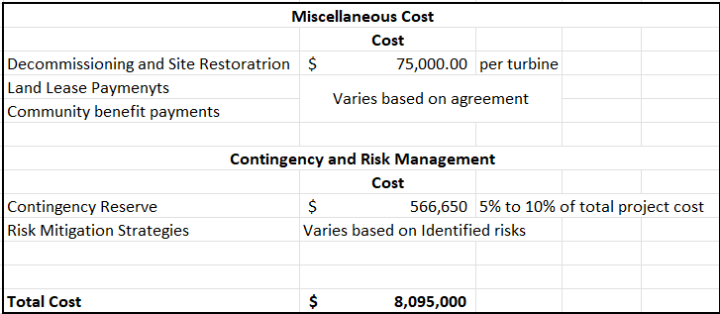
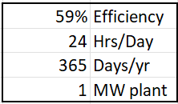
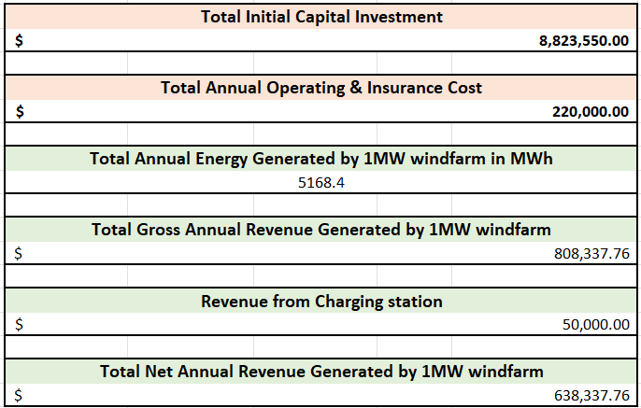
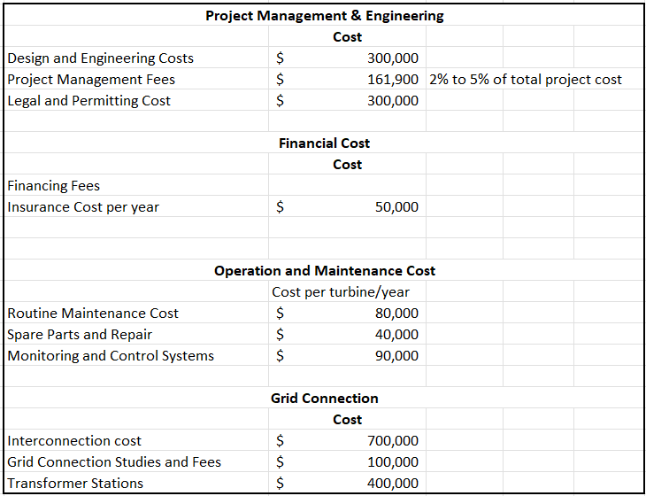
Detailed Cost Estimate of Wind Farm
Energy Calculation

Slide 11
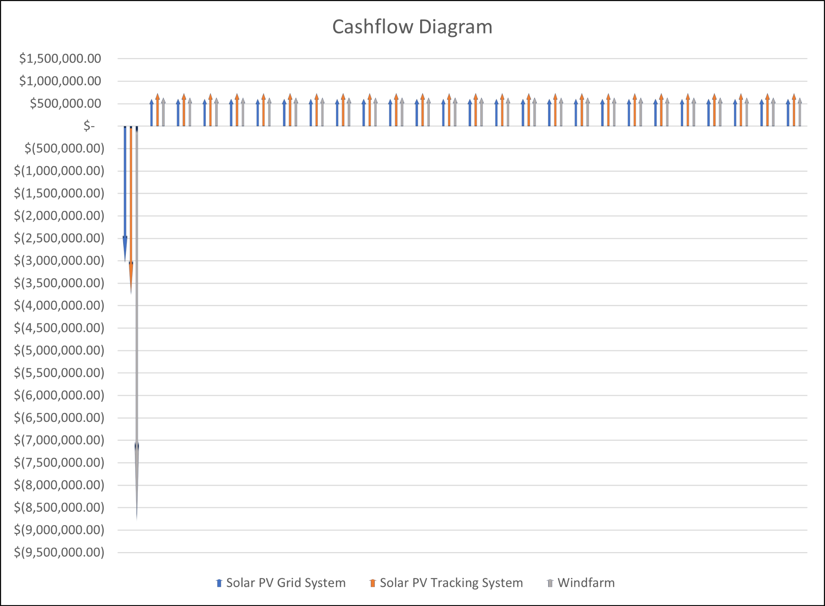
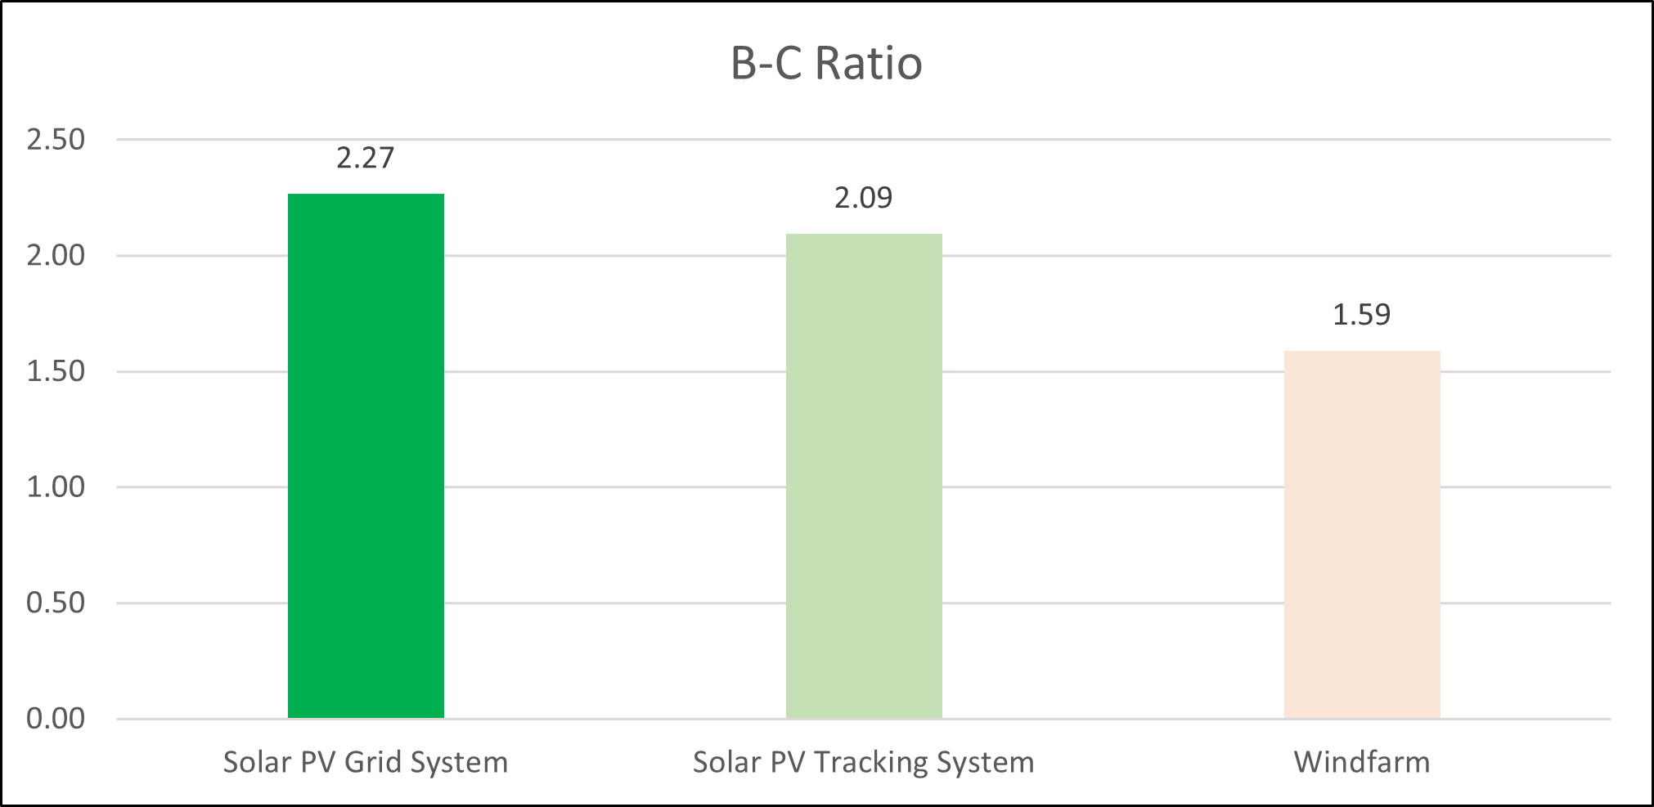
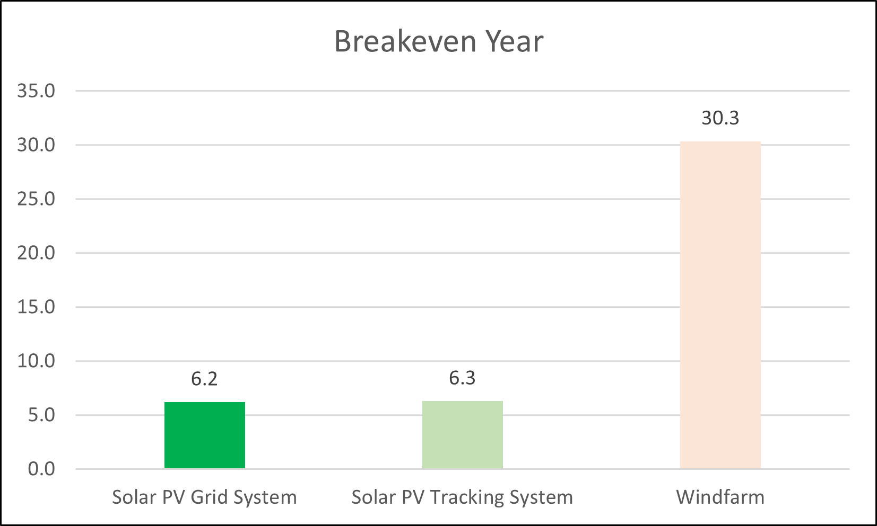
Comparison Among Alternatives

Slide 12
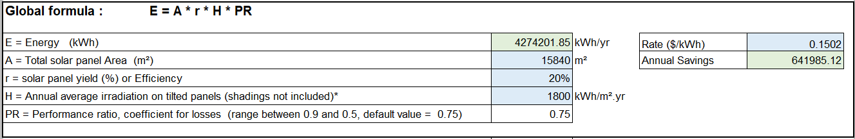
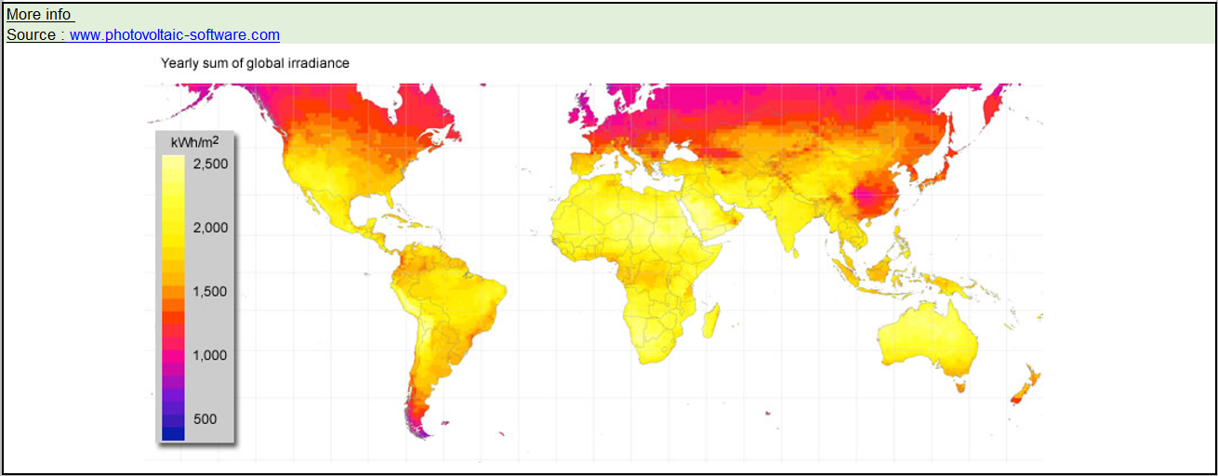
Energy Calculation

Slide 13
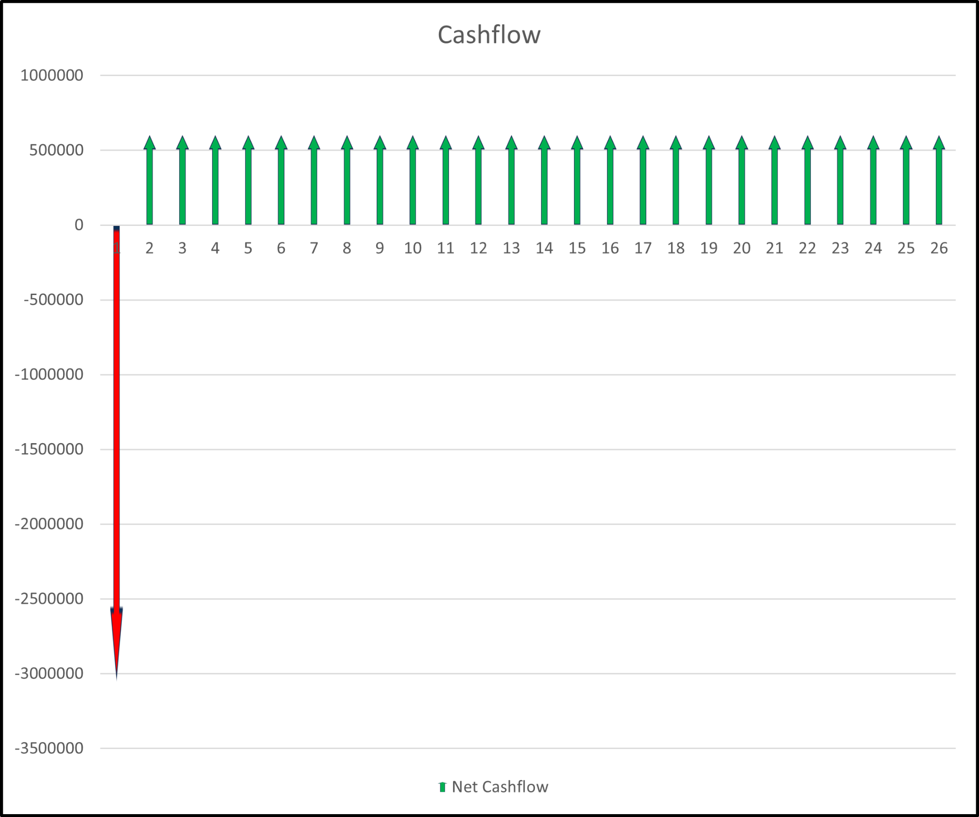
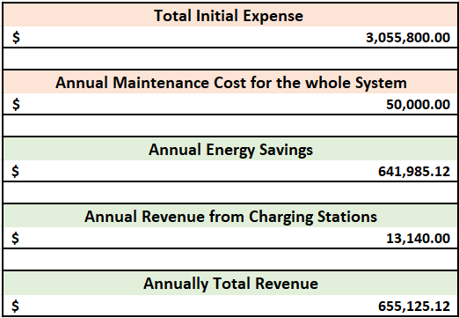

Cash Flow Diagram

Slide 14
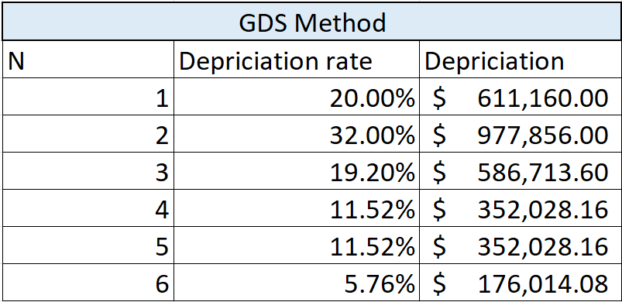
Depreciation
Basis Cost:- $ 3,055,800.00

Slide 15
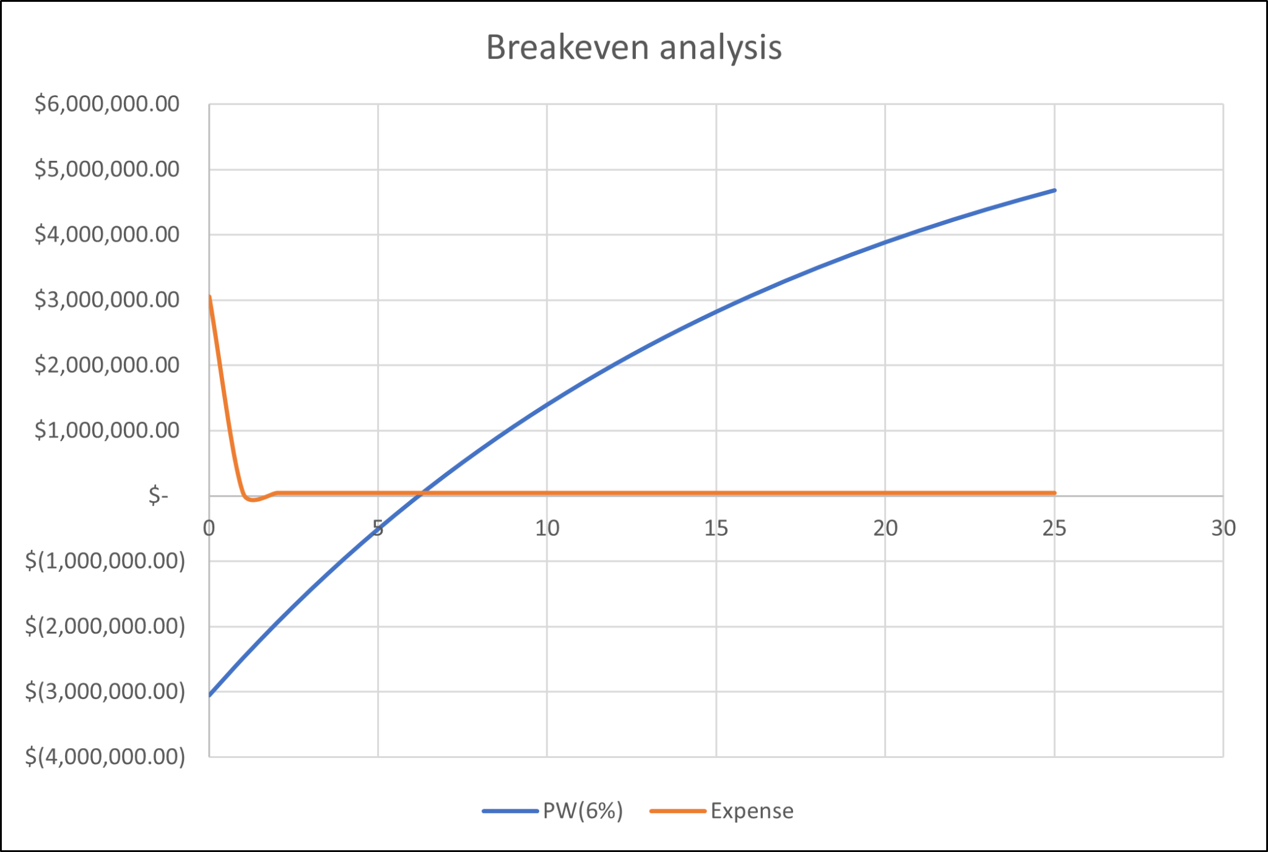
Break Even Analysis

Slide 16
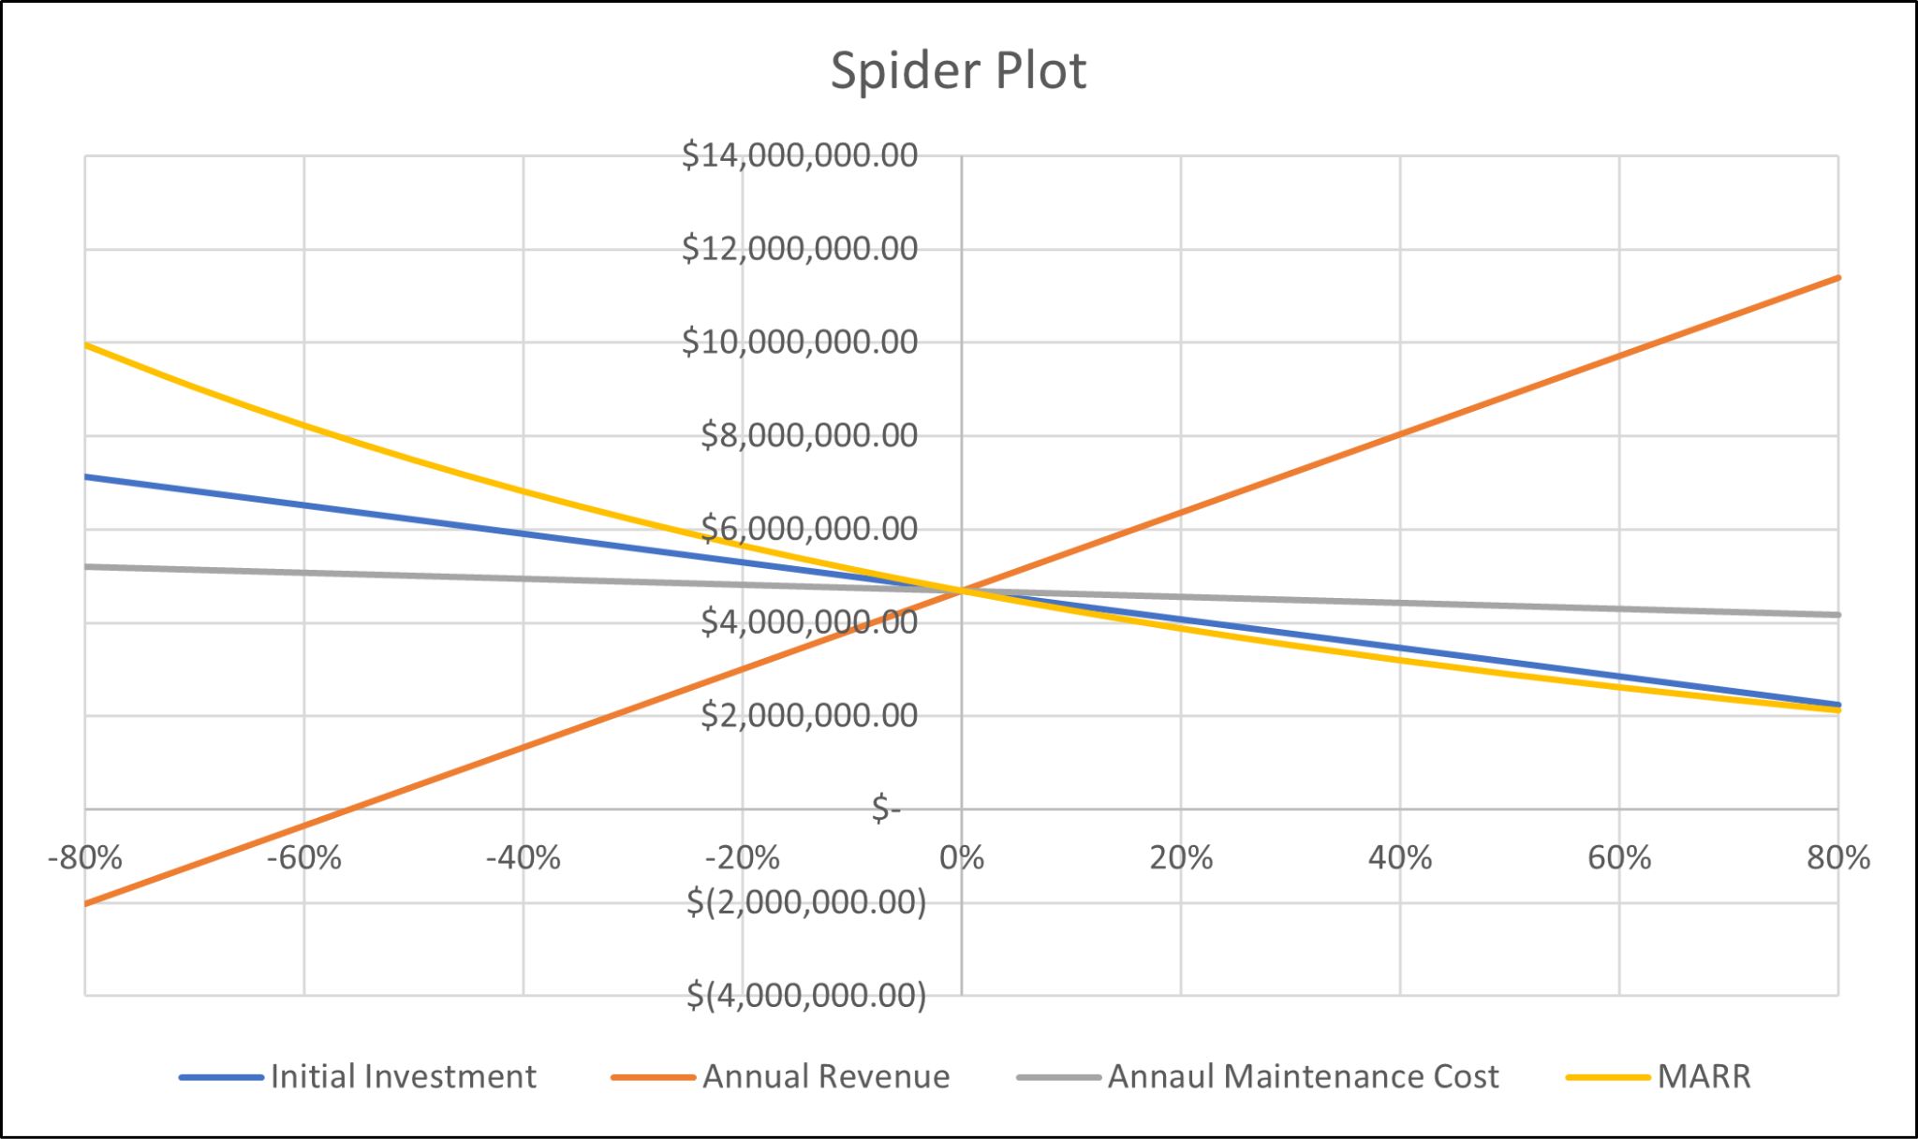
Sensitivity Analysis

Slide 17
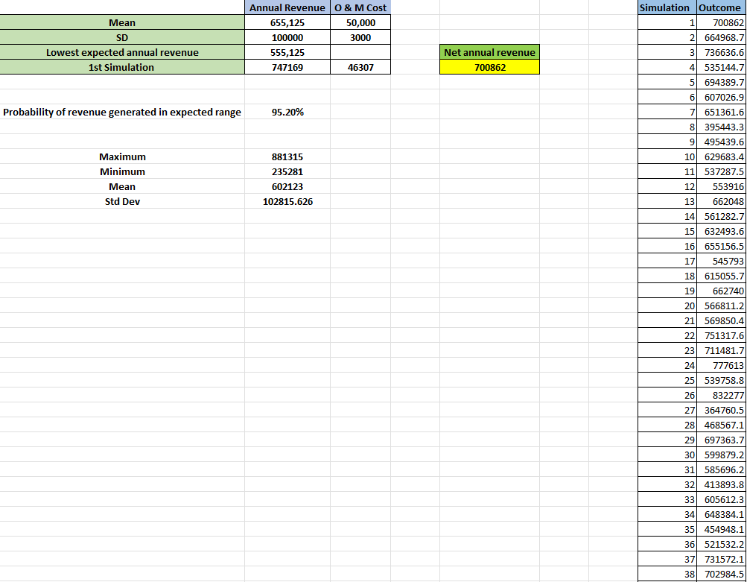
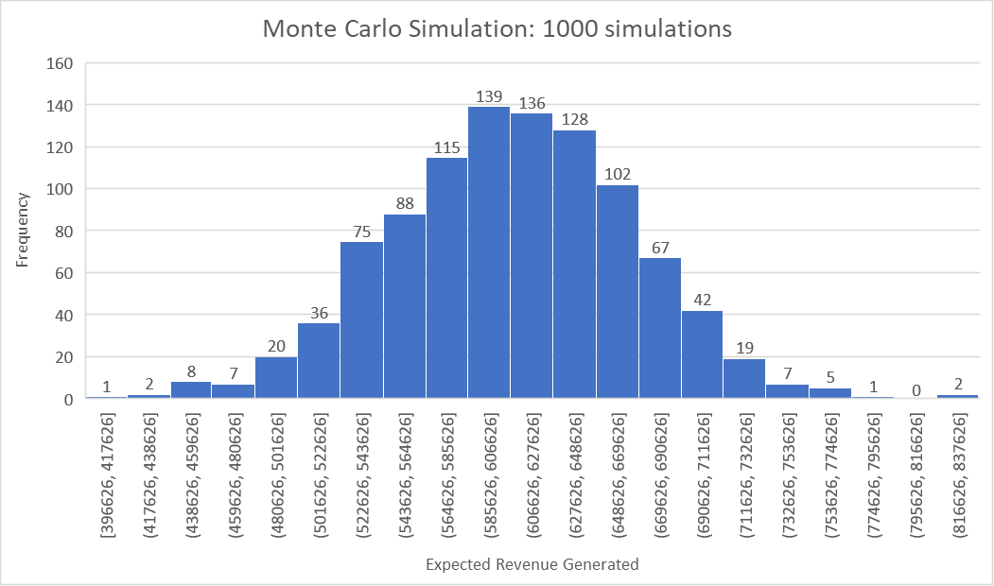
Probabilistic Risk Analysis: Monte Carlo Simulation

Slide 18
Multi-attribute Analysis: Lexicography Method
Attribute | Solar Grid | Single Axis Tracking System | Wind Turbine | Preference | Minimum
Safety | High | High | Low | Higher | Medium
Break even point | 6.2 | 6.3 | 30.3 | Earlier | <10 years
Capital Investment | $3,055,800 | $3,768,600 | $8,823,550 | Lower | <5,000,000
Annual Revenue | $655,125 | $847,720 | $808,337 | Higher | >500,000
Efficiency | 20% | 20% | 59% | Higher | >=20%
Area | Medium | Medium | Large | Lower | <Lot 64
Feasibility | 5 | 4 | 2 | Maximum | 3(0-5)
Maintenance & Operating Cost | $50,000 | $110,000 | $220,000 | Lower | Variable
Ranking from High to Low Importance

Slide 19
Multi-attribute Analysis: Dominance Method
Attribute | Solar Grid VS Single Axis Tracking | Solar Grid VS Wind Turbine | Wind Turbine VS Single Axis Tracking
Safety | Same | Better | Worse
Break even point | Better | Better | Worse
Capital Investment | Better | Better | Worse
Annual Revenue | Worse | Worse | Better
Efficiency | Worse | Worse | Better
Area | Same | Better | Worse
Feasibility | Better | Better | Worse
Maintenance & Operating Cost | Better | Better | Worse
Dominance | No | No | No

Slide 20
Conclusion
Conclusion – Solar Parking lot with - Present worth: $12,069,665.52.
It can be concluded it is better to be endorsing the installation of Solar PV grid as a long-term solution to the university's energy requirements. It highlights the project's long-term sustainability, environmental advantages, and economic feasibility.
The thorough significance of precisely projecting costs to guarantee economic viability, including startup and running costs has been done.
Risk and Uncertainty in Economic Projections:
Insights into the impact of uncertain economic variables on cash flow projections.
Financial Analysis Insights: Understandings gained from financial analyses (NPV, IRR, breakeven) in evaluating the project's economic feasibility.

Slide 21
Thank you!

